Slide 1
BIEN 401 Biomedical Mass Transport Class 11 Solute Permeability and Heterogenous Materials
notes prepared by
Dr. Louis Reis
Created on 3/31/2022

Slide 2
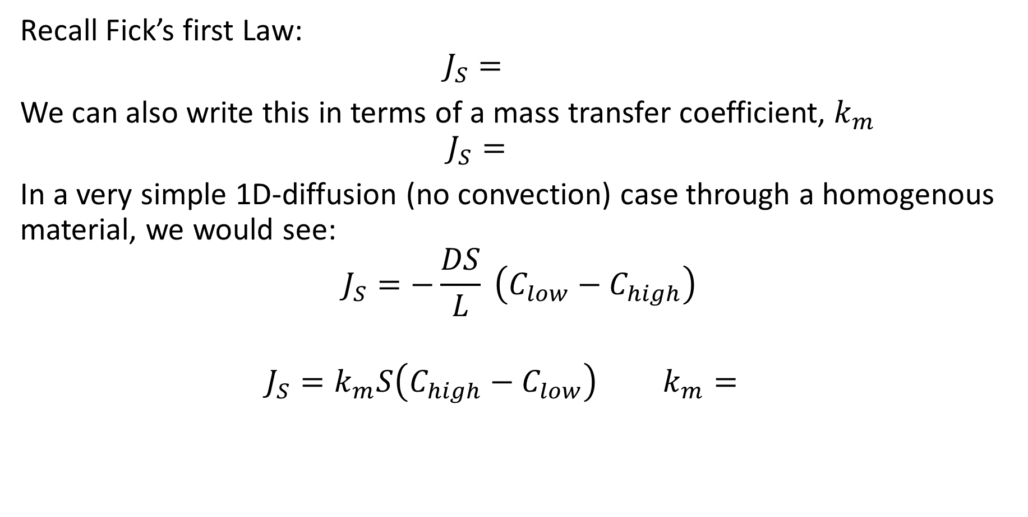
Fick’s Laws and Mass Transfer Coefficients: Review
Recall Fick’s first Law:
$$J_{S}=$$
We can also write this in terms of a mass transfer coefficient, $k_{m}$
$$J_{S}=$$
In a very simple 1D-diffusion (no convection) case through a homogenous material, we would see:
$$J_{S}=−\frac{DS}{L} \left(C_{low}−C_{high}\right)$$
$$J_{S}=k_{m}S\left(C_{high}−C_{low}\right) k_{m}=$$

Slide 3
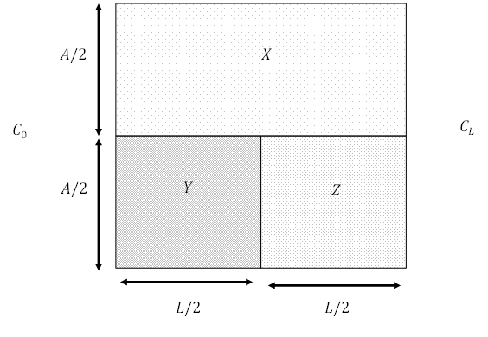



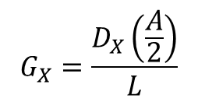
Heterogenous Materials and Effective Diffusivities
We saw that the transfer rate of a solute is analogous to electrical current through a resistor (or conductance)
$$J_{S}=(k_{m}S) ∆C ↔ I=G∆V$$
$$G_{X}=\frac{D_{X}\left(\frac{A}{2}\right)}{L}$$
$$G_{Y}=\frac{D_{Y}\left(\frac{A}{2}\right)}{\left(\frac{L}{2}\right)}$$
$$G_{Z}=\frac{D_{Z}\left(\frac{A}{2}\right)}{\left(\frac{L}{2}\right)}$$

Slide 4
Solute Diffusion in a Pore
We have looked at solvent transfer through a porous membrane.
If the pore is very large compared to the solute, then we can treat the medium as any normal homogenous material.
If the solute diameter and pore diameter are comparable, then additional resistances must be factored in (note if the solute is larger than the pore, then it will not diffuse through the pore).
The first resistance encountered is at the pore entrance, known as the ___________________ effect.
The second resistance occurs due to an increase in _____________ within the pore, known as hindered diffusion.

Slide 5

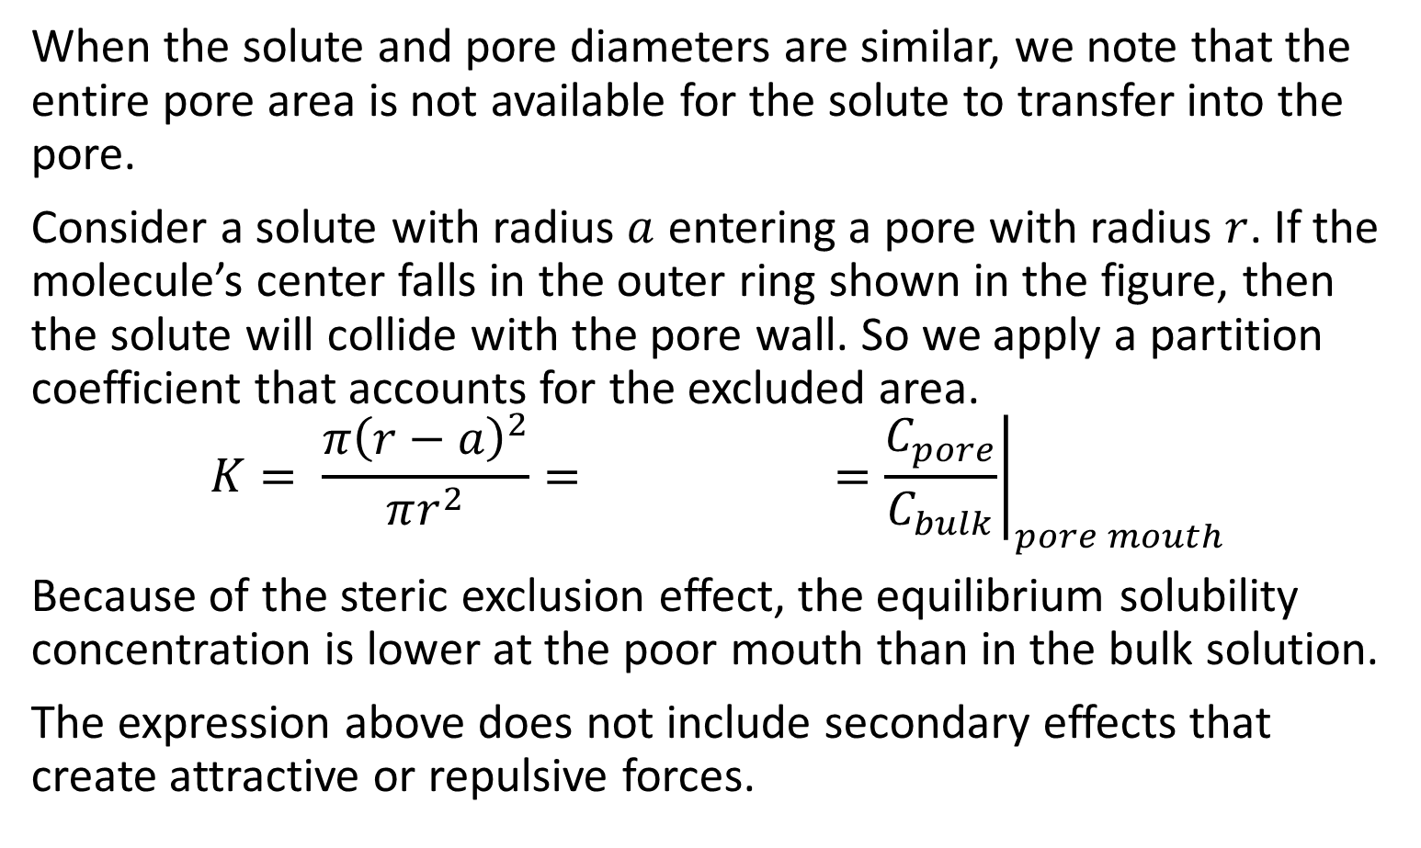

Steric Exclusion
When the solute and pore diameters are similar, we note that the entire pore area is not available for the solute to transfer into the pore.
Consider a solute with radius $a$ entering a pore with radius $r$. If the molecule’s center falls in the outer ring shown in the figure, then the solute will collide with the pore wall. So we apply a partition coefficient that accounts for the excluded area.
$$K= \frac{π{\left(r−a\right)}^{2}}{πr^{2}}= ={\left.\frac{C_{pore}}{C_{bulk}}\right|}_{pore mouth}$$
Because of the steric exclusion effect, the equilibrium solubility concentration is lower at the poor mouth than in the bulk solution.
The expression above does not include secondary effects that create attractive or repulsive forces.
$$r$$
$$r−a$$

Slide 6
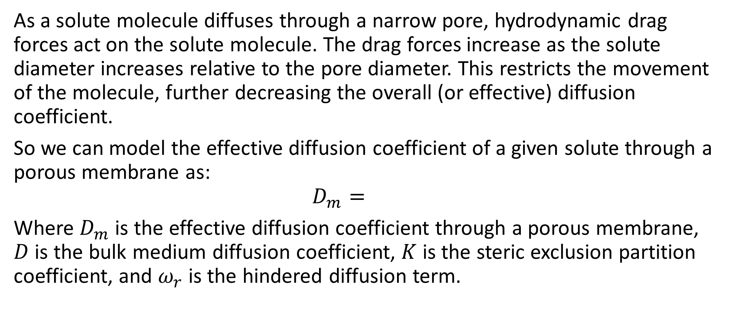
Hindered Diffusion
As a solute molecule diffuses through a narrow pore, hydrodynamic drag forces act on the solute molecule. The drag forces increase as the solute diameter increases relative to the pore diameter. This restricts the movement of the molecule, further decreasing the overall (or effective) diffusion coefficient.
So we can model the effective diffusion coefficient of a given solute through a porous membrane as:
$$D_{m}=$$
Where $D_{m}$ is the effective diffusion coefficient through a porous membrane, $D$ is the bulk medium diffusion coefficient, $K$ is the steric exclusion partition coefficient, and $ω_{r}$ is the hindered diffusion term.

Slide 7
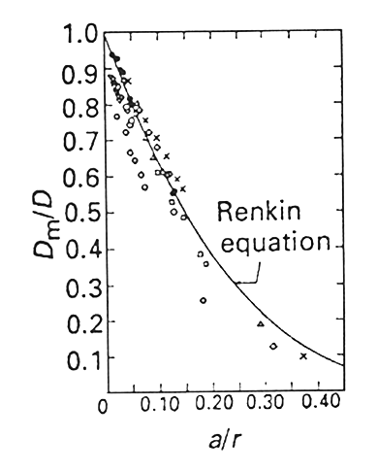
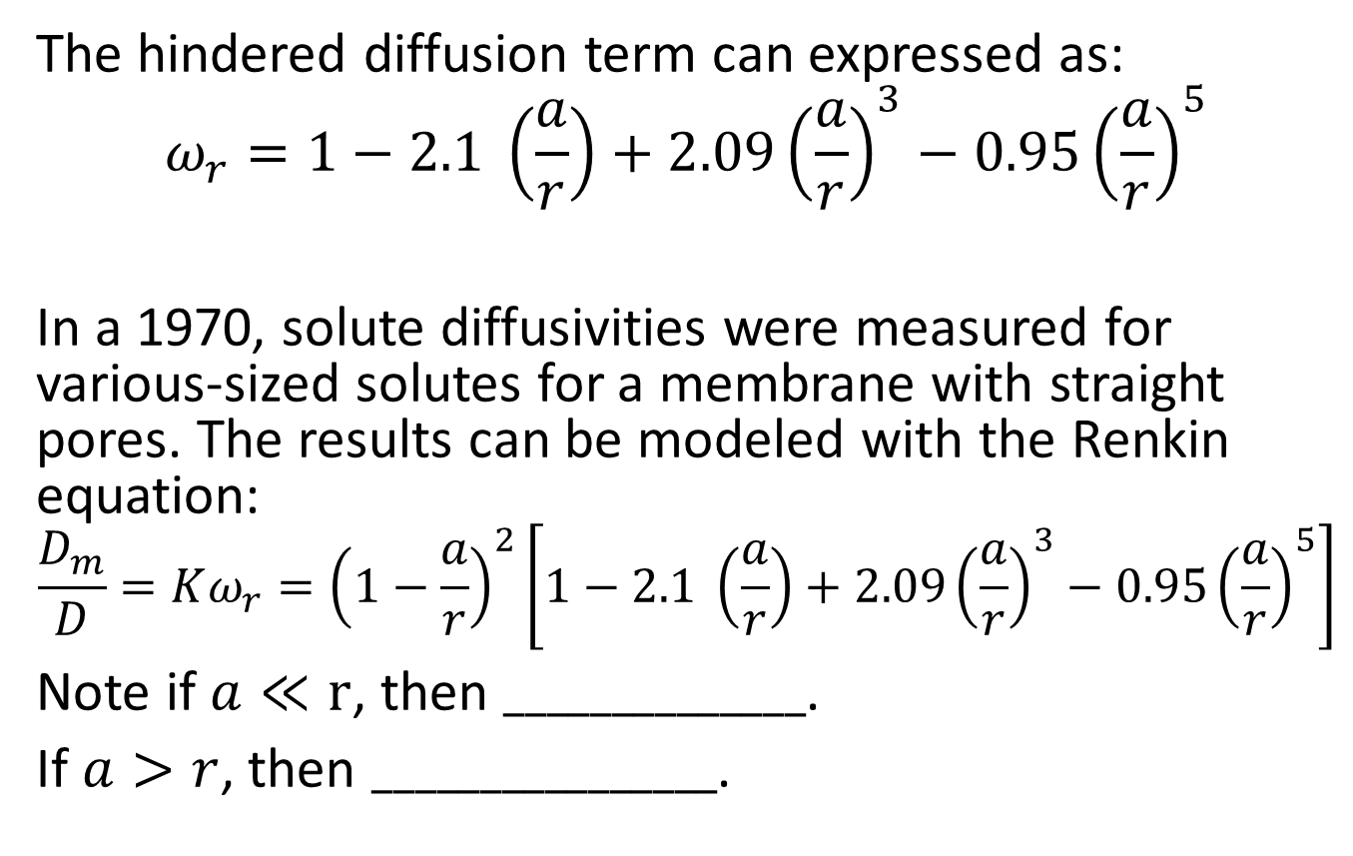
Hindered Diffusion
The hindered diffusion term can expressed as:
$$ω_{r}=1−2.1 \left(\frac{a}{r}\right)+2.09{\left(\frac{a}{r}\right)}^{3}−0.95{\left(\frac{a}{r}\right)}^{5}$$
In a 1970, solute diffusivities were measured for various-sized solutes for a membrane with straight pores. The results can be modeled with the Renkin equation:
$$\frac{D_{m}}{D}=Kω_{r}={\left(1−\frac{a}{r}\right)}^{2}\left[1−2.1 \left(\frac{a}{r}\right)+2.09{\left(\frac{a}{r}\right)}^{3}−0.95{\left(\frac{a}{r}\right)}^{5}\right]$$
Note if $a≪r$, then $______________$.
If $a>r$, then $________________$.

Slide 8
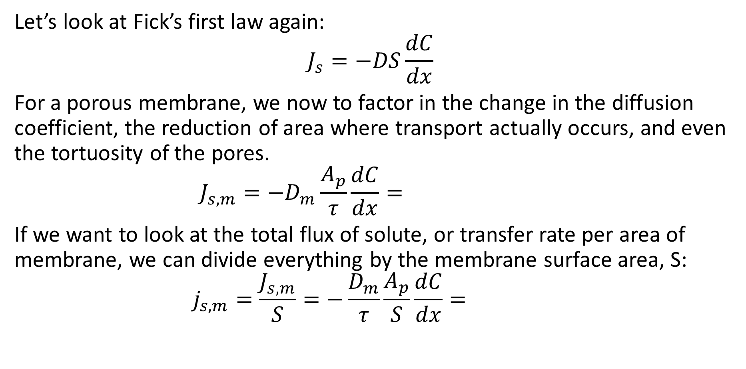
Fick’s First Law and Membrane Diffusion
Let’s look at Fick’s first law again:
$$J_{s}=−DS\frac{dC}{dx}$$
For a porous membrane, we now to factor in the change in the diffusion coefficient, the reduction of area where transport actually occurs, and even the tortuosity of the pores.
$$J_{s,m}=−D_{m}\frac{A_{p}}{τ}\frac{dC}{dx}=$$
If we want to look at the total flux of solute, or transfer rate per area of membrane, we can divide everything by the membrane surface area, S:
$$j_{s,m}=\frac{J_{s,m}}{S}=−\frac{D_{m}}{τ}\frac{A_{p}}{S}\frac{dC}{dx}=$$

Slide 9
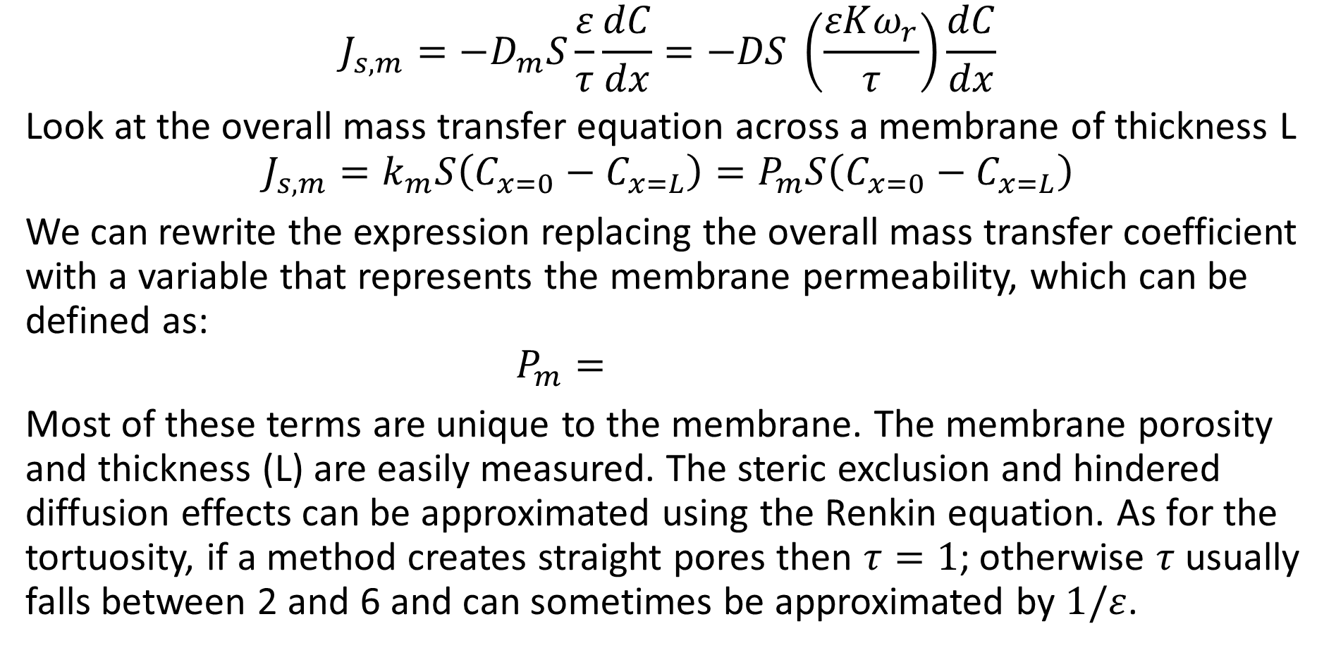
Membrane Permeability
$$J_{s,m}=−D_{m}S\frac{ε}{τ}\frac{dC}{dx}=−DS \left(\frac{εKω_{r}}{τ}\right)\frac{dC}{dx}$$
Look at the overall mass transfer equation across a membrane of thickness L
$$J_{s,m}=k_{m}S\left(C_{x=0}−C_{x=L}\right)=P_{m}S\left(C_{x=0}−C_{x=L}\right)$$
We can rewrite the expression replacing the overall mass transfer coefficient with a variable that represents the membrane permeability, which can be defined as:
$$P_{m}=$$
Most of these terms are unique to the membrane. The membrane porosity and thickness (L) are easily measured. The steric exclusion and hindered diffusion effects can be approximated using the Renkin equation. As for the tortuosity, if a method creates straight pores then $τ=1$; otherwise $τ$ usually falls between 2 and 6 and can sometimes be approximated by $1/ε$.

Slide 10
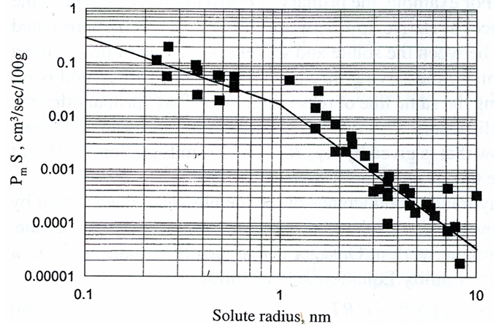

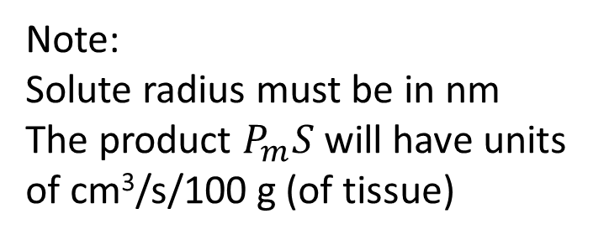
Capillary Wall Permeability
We know that the capillary’s thin walls and intracellular clefts make it ideal for solute transport into the surrounding tissue. The plot (from Renkin and Curry) below shows that most solute molecules follow the piecewise equation:
$$P_{m}S= \left\{\begin{matrix}0.0184 a^{−1.223} \text{for} a<1 nm \\ 0.0287 a^{−2.92} \text{f}\text{or} a>1 nm\end{matrix}\right.$$
Note:
Solute radius must be in nm
The product $P_{m}S$ will have units of cm³/s/100 g (of tissue)

Slide 11
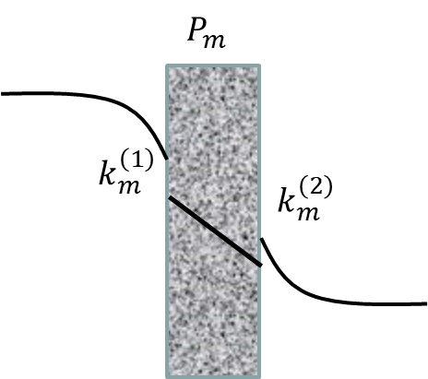
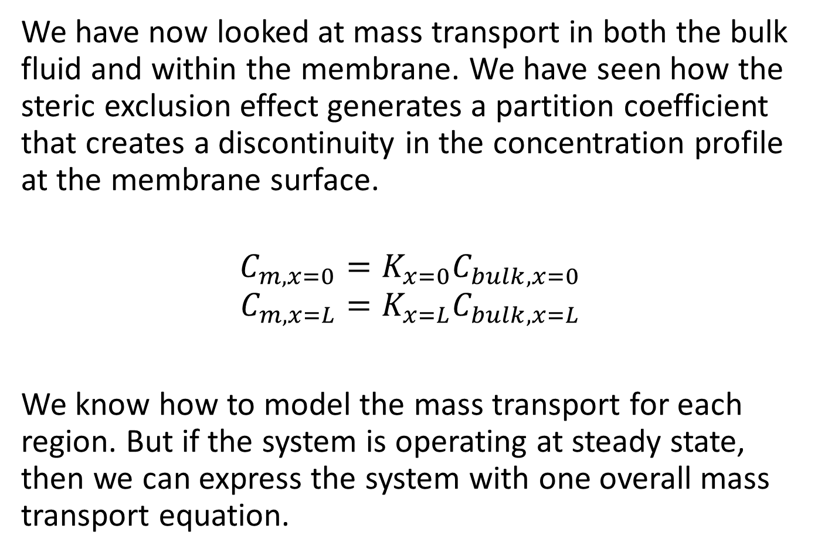
Overall Mass Transfer Coefficient
We have now looked at mass transport in both the bulk fluid and within the membrane. We have seen how the steric exclusion effect generates a partition coefficient that creates a discontinuity in the concentration profile at the membrane surface.
$$C_{m,x=0}=K_{x=0}C_{bulk,x=0}$$
$$C_{m,x=L}=K_{x=L}C_{bulk,x=L}$$
We know how to model the mass transport for each region. But if the system is operating at steady state, then we can express the system with one overall mass transport equation.

Slide 12
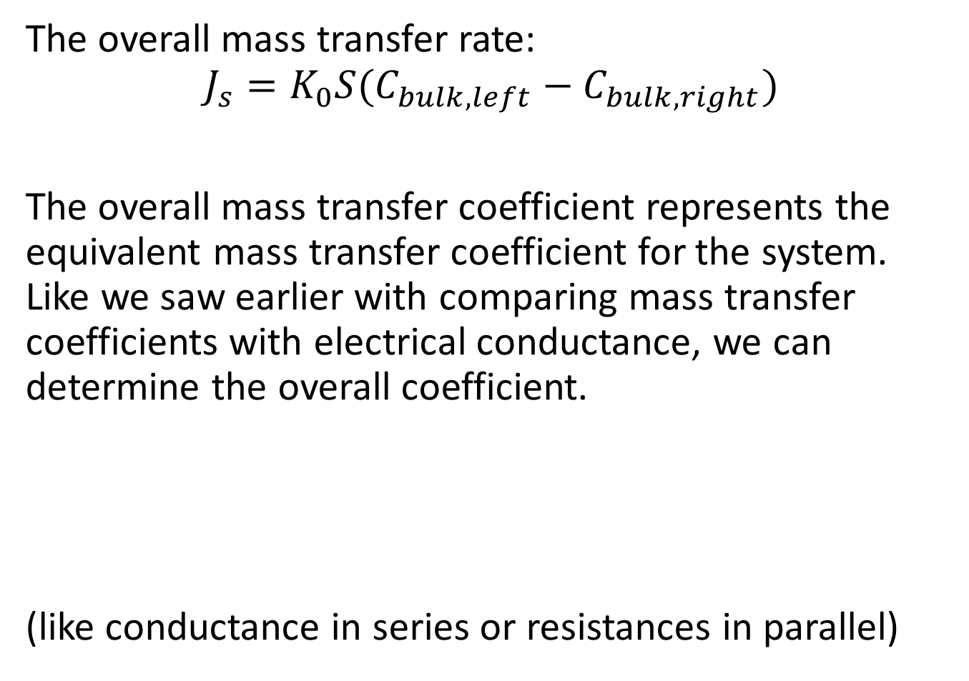
Overall Mass Transfer Coefficient
The overall mass transfer rate:
$$J_{s}=K_{0}S(C_{bulk,left}−C_{bulk,right})$$
The overall mass transfer coefficient represents the equivalent mass transfer coefficient for the system. Like we saw earlier with comparing mass transfer coefficients with electrical conductance, we can determine the overall coefficient.
(like conductance in series or resistances in parallel)

Slide 13
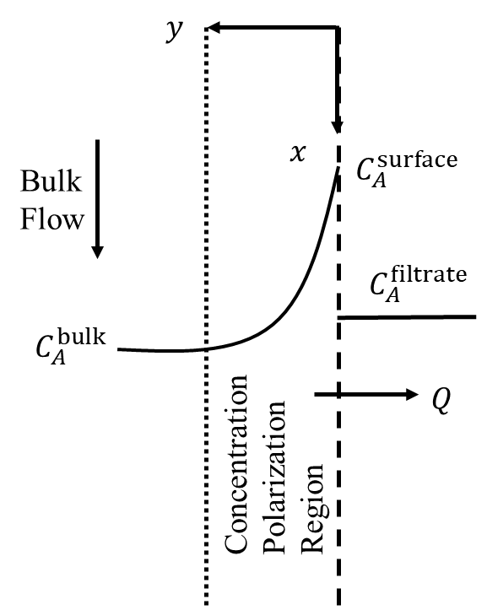
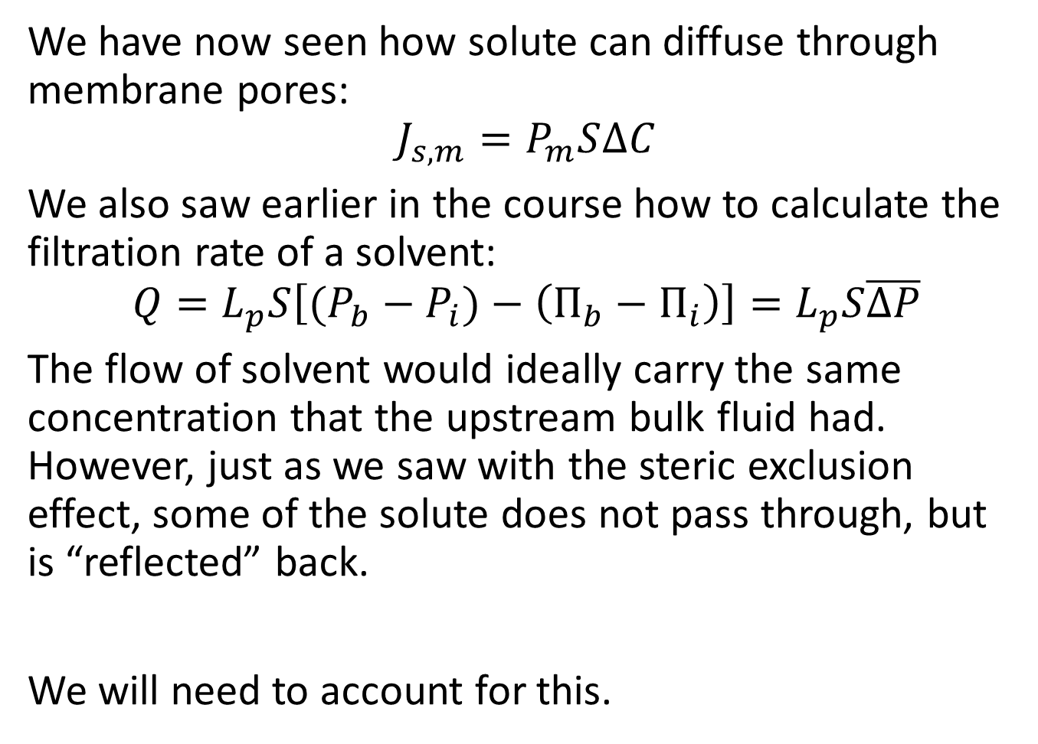
Flux by Convection and Diffusion
We have now seen how solute can diffuse through membrane pores:
$$J_{s,m}=P_{m}S∆C$$
We also saw earlier in the course how to calculate the filtration rate of a solvent:
$$Q=L_{p}S\left[(P_{b}−P_{i})−\left(Π_{b}−Π_{i}\right)\right]=L_{p}S\overline{∆P}$$
The flow of solvent would ideally carry the same concentration that the upstream bulk fluid had. However, just as we saw with the steric exclusion effect, some of the solute does not pass through, but is “reflected” back.
We will need to account for this.

Slide 14
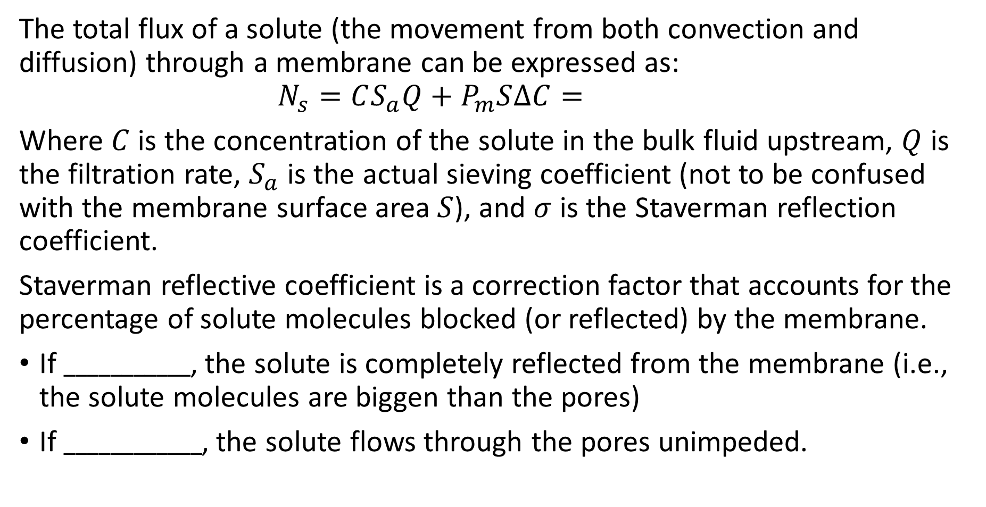
Flux by Convection and Diffusion
The total flux of a solute (the movement from both convection and diffusion) through a membrane can be expressed as:
$$N_{s}=CS_{a}Q+P_{m}S∆C=$$
Where $C$ is the concentration of the solute in the bulk fluid upstream, $Q$ is the filtration rate, $S_{a}$ is the actual sieving coefficient (not to be confused with the membrane surface area $S$), and $σ$ is the Staverman reflection coefficient.
Staverman reflective coefficient is a correction factor that accounts for the percentage of solute molecules blocked (or reflected) by the membrane.
If $___________$, the solute is completely reflected from the membrane (i.e., the solute molecules are biggen than the pores)
If $____________$, the solute flows through the pores unimpeded.

Slide 15
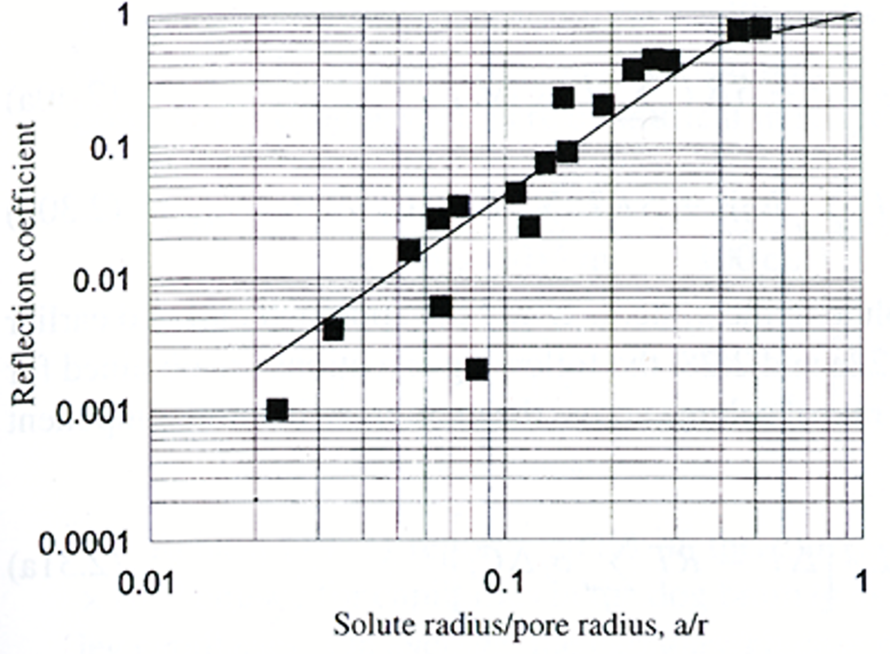
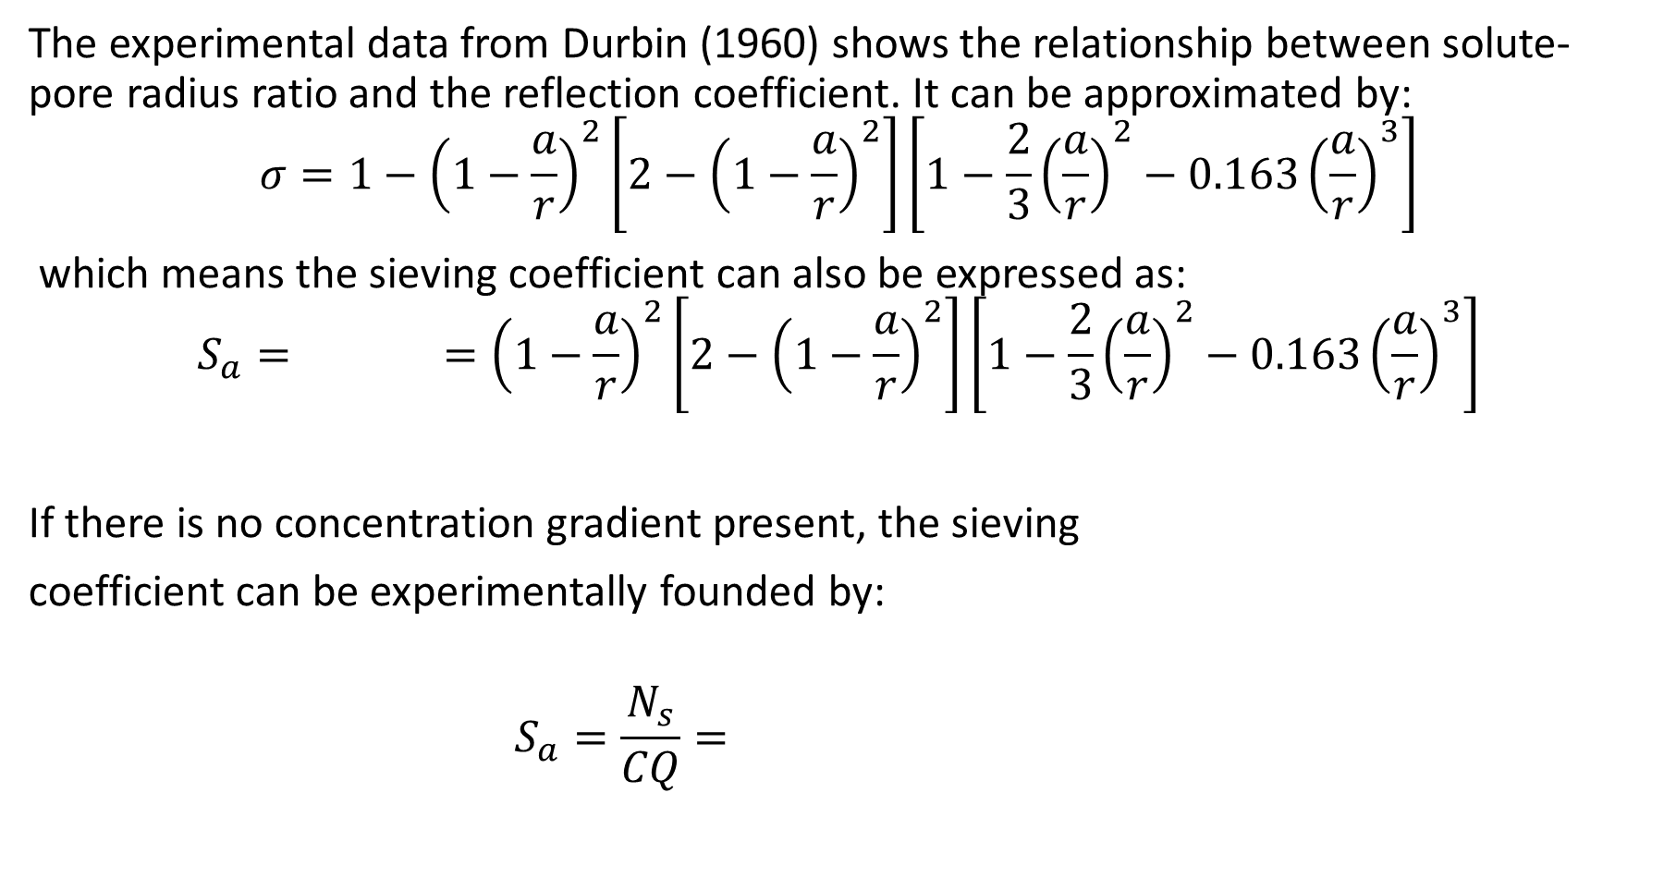
Reflection Coefficient
The experimental data from Durbin (1960) shows the relationship between solute-pore radius ratio and the reflection coefficient. It can be approximated by:
$$σ=1−{\left(1−\frac{a}{r}\right)}^{2}\left[2−{\left(1−\frac{a}{r}\right)}^{2}\right]\left[1−\frac{2}{3}{\left(\frac{a}{r}\right)}^{2}−0.163{\left(\frac{a}{r}\right)}^{3}\right]$$
which means the sieving coefficient can also be expressed as:
$$S_{a}= ={\left(1−\frac{a}{r}\right)}^{2}\left[2−{\left(1−\frac{a}{r}\right)}^{2}\right]\left[1−\frac{2}{3}{\left(\frac{a}{r}\right)}^{2}−0.163{\left(\frac{a}{r}\right)}^{3}\right]$$
If there is no concentration gradient present, the sieving
coefficient can be experimentally founded by:
$$S_{a}=\frac{N_{s}}{CQ}=$$

Slide 16
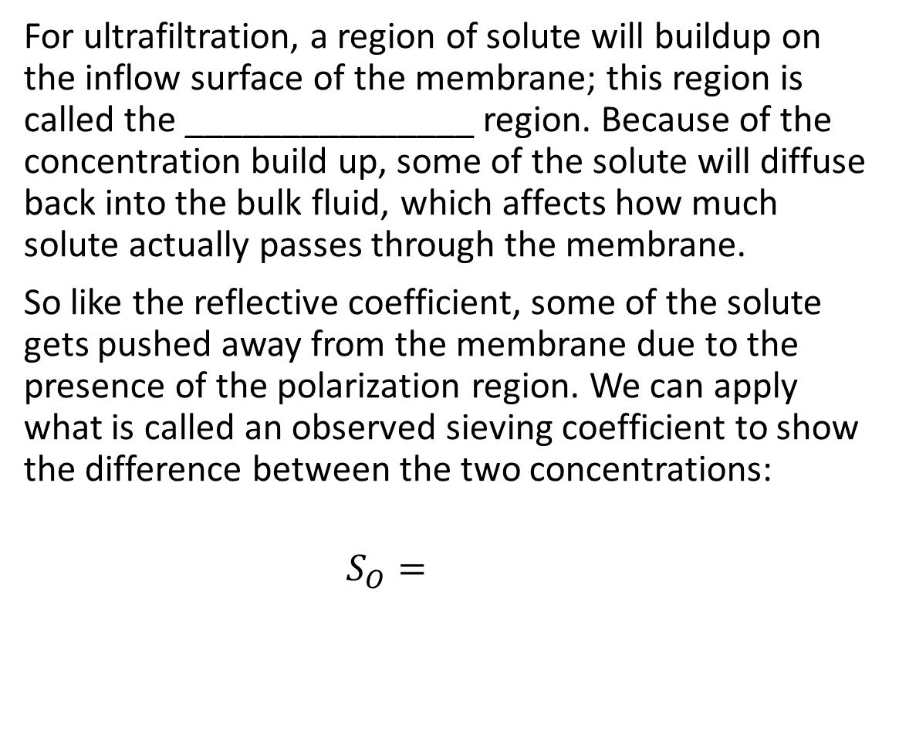
Sieving Coefficient
For ultrafiltration, a region of solute will buildup on the inflow surface of the membrane; this region is called the _______________ region. Because of the concentration build up, some of the solute will diffuse back into the bulk fluid, which affects how much solute actually passes through the membrane.
So like the reflective coefficient, some of the solute gets pushed away from the membrane due to the presence of the polarization region. We can apply what is called an observed sieving coefficient to show the difference between the two concentrations:
$$S_{O}=$$

Slide 17
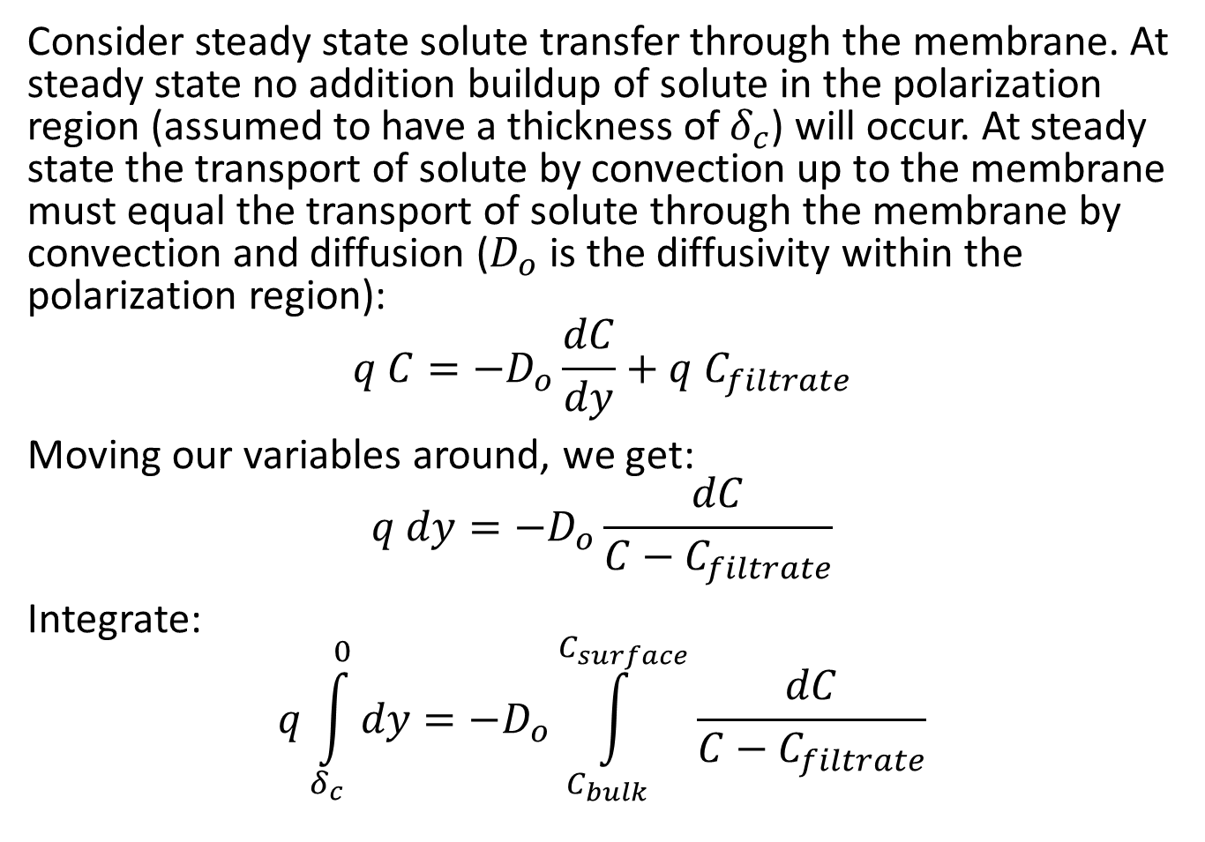
Sieving Coefficient
Consider steady state solute transfer through the membrane. At steady state no addition buildup of solute in the polarization region (assumed to have a thickness of $δ_{c}$) will occur. At steady state the transport of solute by convection up to the membrane must equal the transport of solute through the membrane by convection and diffusion ($D_{o}$ is the diffusivity within the polarization region):
$$q C=−D_{o}\frac{dC}{dy}+q C_{filtrate}$$
Moving our variables around, we get:
$$q dy=−D_{o}\frac{dC}{C−C_{filtrate}}$$
Integrate:
$$q\int_{δ_{c}}^{0}{dy}=−D_{o}\int_{C_{bulk}}^{C_{surface}}{\frac{dC}{C−C_{filtrate}}}$$

Slide 18
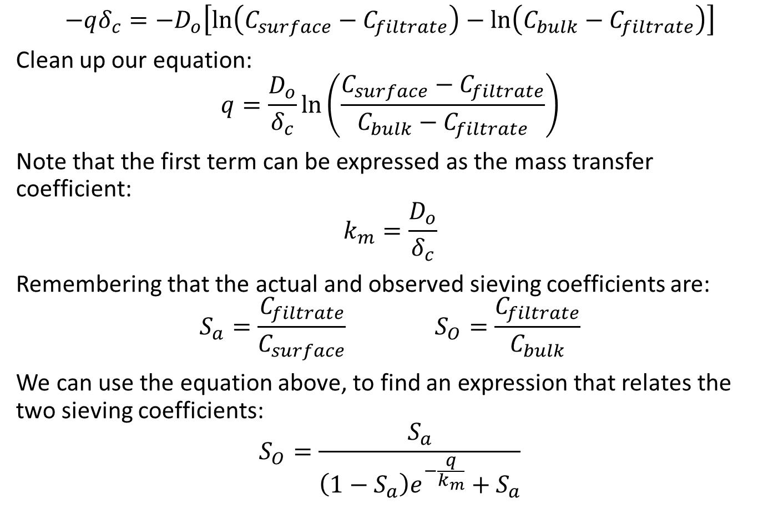
Sieving Coefficient
$$−qδ_{c}=−D_{o}\left[\ln\left(C_{surface}−C_{filtrate}\right)−\ln\left(C_{bulk}−C_{filtrate}\right)\right]$$
Clean up our equation:
$$q=\frac{D_{o}}{δ_{c}}\ln\left(\frac{C_{surface}−C_{filtrate}}{C_{bulk}−C_{filtrate}}\right)$$
Note that the first term can be expressed as the mass transfer coefficient:
$$k_{m}=\frac{D_{o}}{δ_{c}}$$
Remembering that the actual and observed sieving coefficients are:
$$S_{a}=\frac{C_{filtrate}}{C_{surface}} S_{O}=\frac{C_{filtrate}}{C_{bulk}}$$
We can use the equation above, to find an expression that relates the two sieving coefficients:
$$S_{O}=\frac{S_{a}}{\left(1−S_{a}\right)e^{−\frac{q}{k_{m}}}+S_{a}}$$

Slide 19
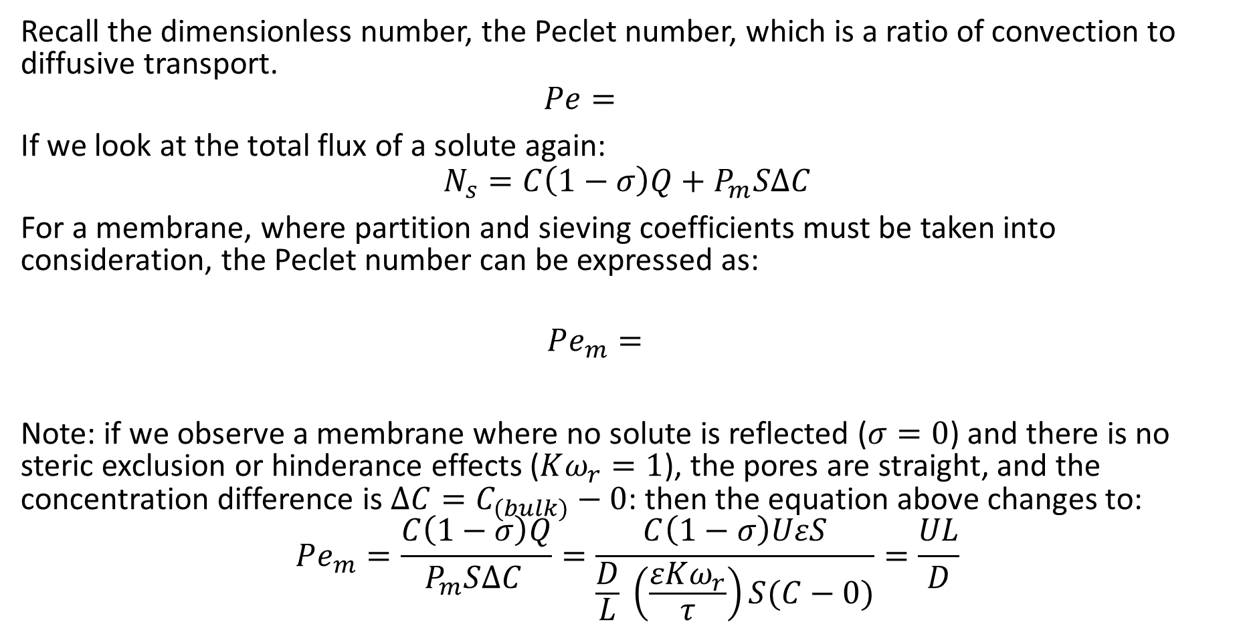
Membrane Peclet Number
Recall the dimensionless number, the Peclet number, which is a ratio of convection to diffusive transport.
$$Pe=$$
If we look at the total flux of a solute again:
$$N_{s}=C\left(1−σ\right)Q+P_{m}S∆C$$
For a membrane, where partition and sieving coefficients must be taken into consideration, the Peclet number can be expressed as:
$$Pe_{m}=$$
Note: if we observe a membrane where no solute is reflected ($σ=0$) and there is no steric exclusion or hinderance effects ($Kω_{r}=1$), the pores are straight, and the concentration difference is $∆C=C_{(bulk)}−0$: then the equation above changes to:
$$Pe_{m}=\frac{C\left(1−σ\right)Q}{P_{m}S∆C }=\frac{C\left(1−σ\right)UεS}{\frac{D}{L} \left(\frac{εKω_{r}}{τ}\right)S(C−0)}=\frac{UL}{D}$$

Slide 20
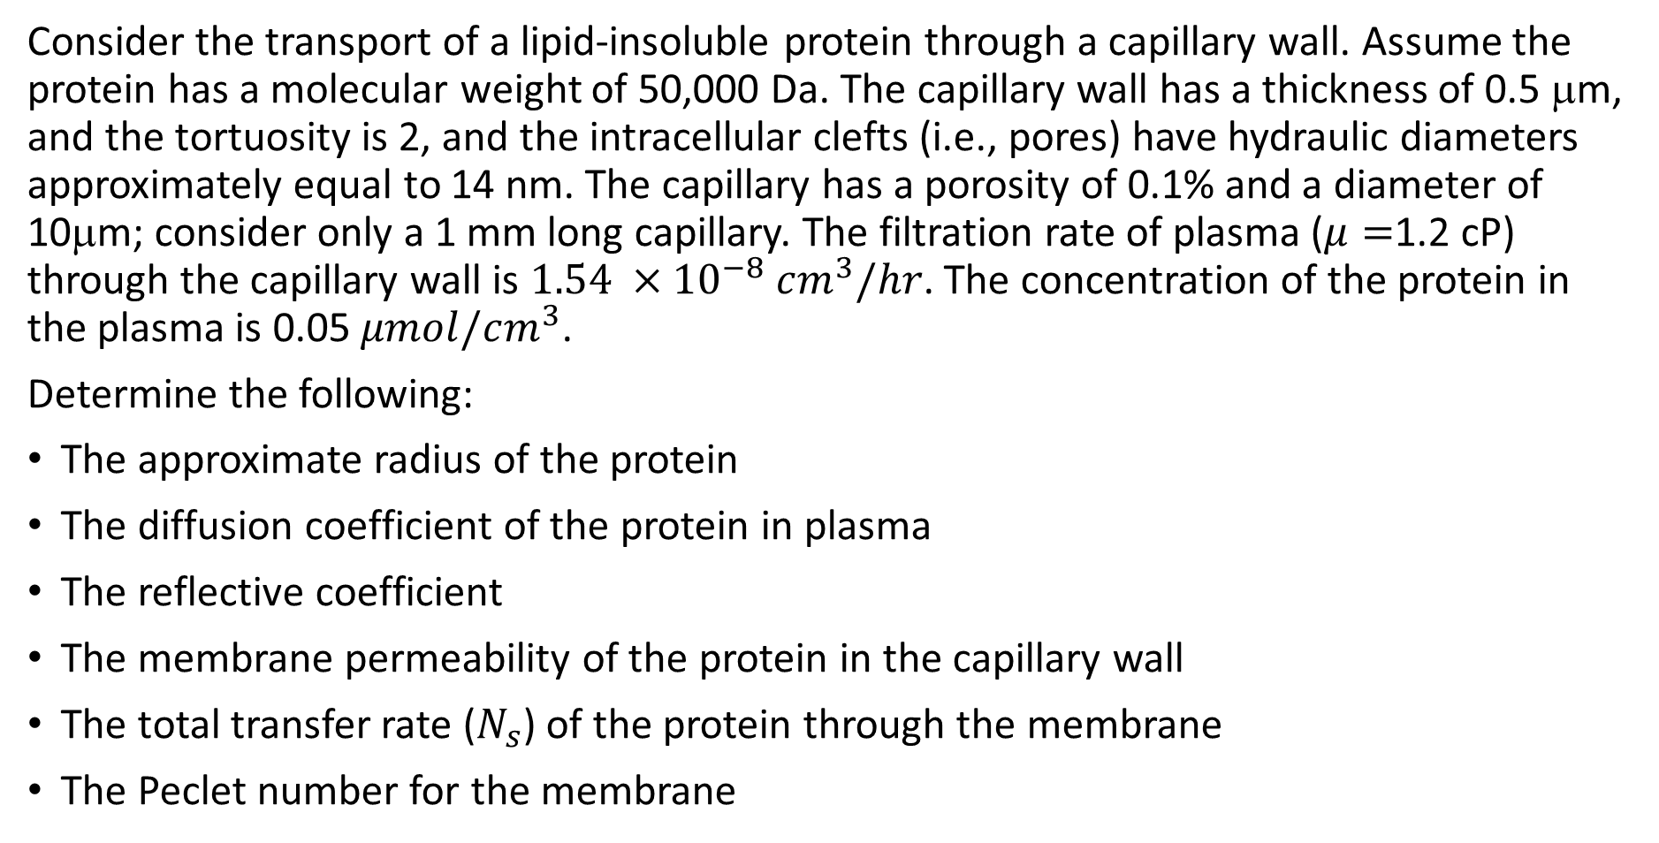
Example
Consider the transport of a lipid-insoluble protein through a capillary wall. Assume the protein has a molecular weight of 50,000 Da. The capillary wall has a thickness of 0.5 μm, and the tortuosity is 2, and the intracellular clefts (i.e., pores) have hydraulic diameters approximately equal to 14 nm. The capillary has a porosity of 0.1% and a diameter of 10μm; consider only a 1 mm long capillary. The filtration rate of plasma ($μ=$1.2 cP) through the capillary wall is $1.54 ×{10}^{−8} cm^{3}/hr$. The concentration of the protein in the plasma is 0.05 $μmol/cm^{3}$.
Determine the following:
The approximate radius of the protein
The diffusion coefficient of the protein in plasma
The reflective coefficient
The membrane permeability of the protein in the capillary wall
The total transfer rate ($N_{s}$) of the protein through the membrane
The Peclet number for the membrane

Slide 21

Example-Solution
We can approximate the solute radius with the equation: (remember that we assume the density is 1 g/cm³)
$$a={\left(\frac{3\left(MW\right)}{4πρ N_{a}}\right)}^{1/3}$$

Slide 22

Example-Solution
For the most accurate solution, we will assume the diffusion coefficient can be modeled using the Renkin and Curry equation:
$$D\left[\frac{cm^{2}}{s}\right]=1.013×{10}^{−4} {\left(MW\right)}^{−0.46}$$
But we must also account for the viscosity differences between water (0.76 cP) and plasma (1.2 cP).

Slide 23

Example-Solution
The reflective coefficient can be found using the expression:
$$σ=1−{\left(1−\frac{a}{r}\right)}^{2}\left[2−{\left(1−\frac{a}{r}\right)}^{2}\right]\left[1−\frac{2}{3}{\left(\frac{a}{r}\right)}^{2}−0.163{\left(\frac{a}{r}\right)}^{3}\right]$$

Slide 24

Example-Solution
The permeability of the capillary wall is:
$$P_{m}=\frac{D}{L} \left(\frac{εKω_{r}}{τ}\right)=\frac{Dε}{Lτ}{\left(1−\frac{a}{r}\right)}^{2}\left[1−2.1 \left(\frac{a}{r}\right)+2.09{\left(\frac{a}{r}\right)}^{3}−0.95{\left(\frac{a}{r}\right)}^{5}\right]$$

Slide 25

Example-Solution
We can now calculate the total transfer rate:
$$N_{s}=C\left(1−σ\right)Q+P_{m}S∆C$$

Slide 26
Example-Solution
We can now calculate the total transfer rate:

